Slide 1

មជ្ឈមណ្ឌលកូរ៉េ សហ្វវែរ អេច អ ឌី
Korea Software HRD Center
Java Presentation Materials
ឣ្នកប្រឹក្សាយោបល់: បណ្ឌិត​​ គីម​ ថេខ្យុង
ឣ្នកណែនំា: លោក លាង ប៊ុនរ៉ុង
លោក លន់ សុវត្ថានា
លោក ផេង តុលា
លោក ដារ៉ា ពេញចិត្ត
www.kshrd.com.kh

Slide 2
ថ្នាក់ សៀមរាប
ក្រុមទី ២
ប្រធានបទ៖ Thread
សមាជិក
១.​ លោក អ៊ាង ភារា
២. លោក សឹង​ ចាន់ឆៃហេង
៣. លោក គង់ សុផានិត
៤. លោក ហៀម សីហា
៥. លោក លី គីមសៀ

Slide 3
មាតិកា
១.​ ស្វែងយល់ពី Program, Process, Thread Concept
២. សែ្វងយល់ពី The Two Ways of Implementation Thread
៣. សែ្វងយល់ពី​ Commonly Used Methods in Thread Class
៤. ស្វែងយល់ពី Synchronization

Slide 4
១.​ ស្វែងយល់ពី Program, Process, Thread Concept
អ្វីទៅជា​ Program?
អាចហៅម្យ៉ាងទៀតថា concurrent program ។ សំដៅលើកម្មវិធី ឬ ប្រតិបត្តិការដែលមានដំណើរការច្រើនក្នុងពេលតែមួយ ។ ឧទាហរណ៏៖ we type text while we listen to music.
នៅក្នុង concurrent programming វាមានផ្នែកពីរសំខាន់ៗគឺ processes and threads.

Slide 5
១.​ ស្វែងយល់ពី Program, Process, Thread Concept​ (ត)
អ្វីទៅជា Process?
វាមាន own memory space
អ្វីទៅជា​ Thread?
basically a lightweight sub-process, a smallest unit of processing.
Lightweight processes
Exist after process occur
Every process have thread at least one

Slide 6
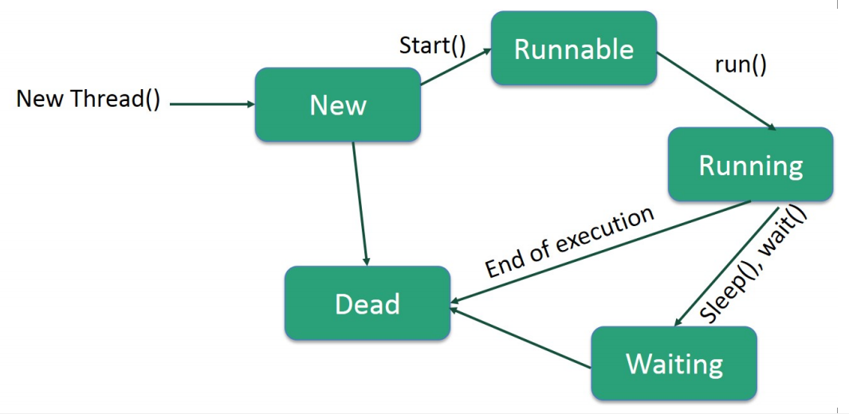
Life Cycle of a Thread:

Slide 7
២. សែ្វងយល់ពី The Two Ways of Implementation Thread
១. របៀបទីមួយនៃការ Implement Thread ដោយ Implement Runnable Interface:
ដើម្បីបង្កើត Thread តាមរយះការ Implement Runnable Interface យើងត្រូវឆ្លងកាត់ដំណាក់កាលមួយចំនួនដូចខាងក្រោម:
ជំហានដំបូង​ យើងត្រូវការ Implement run​ method ដែលផ្ដល់ដោយ Runnable Interface
ឧទាហរណ៍ public void run()
ជំហានទី ២: យើងត្រូវការ Instantiate Thread Object ដោយប្រើប្រាស់ Constructor
Thread(Runnable threadObj, String threadName);
ជំហានទី​ ៣: នៅពេលដែល threadObj ត្រូវបានបង្កើតរួចហើយ​ នោះយើងអាច ហៅ​ Method start ដែលក្នុងការដំណើរការ Thread ។

Slide 8
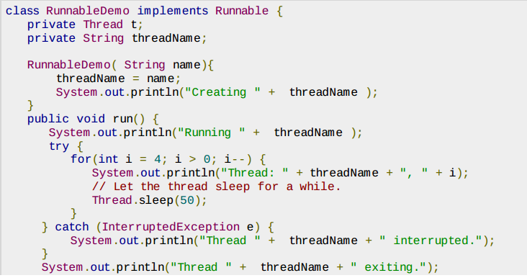
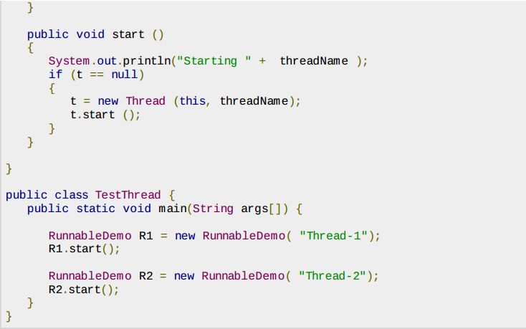
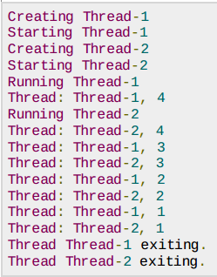
២. សែ្វងយល់ពី The Two Ways of Implementation Thread (ត)
ឧទាហរណ៍៖
Result:

Slide 9
២. សែ្វងយល់ពី The Two Ways of Implementation Thread (ត)
២. របៀបទីពីនៃការ Implement Thread ដោយ ​Extend Thread Class:
ដើម្បីបង្កើត Thread តាមរយះការ ​Extend Thread Class យើងត្រូវឆ្លងកាត់ដំណាក់កាលមួយចំនួនដូចខាងក្រោម:
ជំហានដំបូង​ យើងត្រូវការ Override run​ method ដែលនៅក្នុង Thread Class
ឧទាហរណ៍ public void run()
ជំហានទី ២: នៅពេលដែល threadObj ត្រូវបានបង្កើតរួចហើយ យើងអាចចាប់ដំណើរវាដោយប្រើប្រាស់​ Method start()
void start();

Slide 10
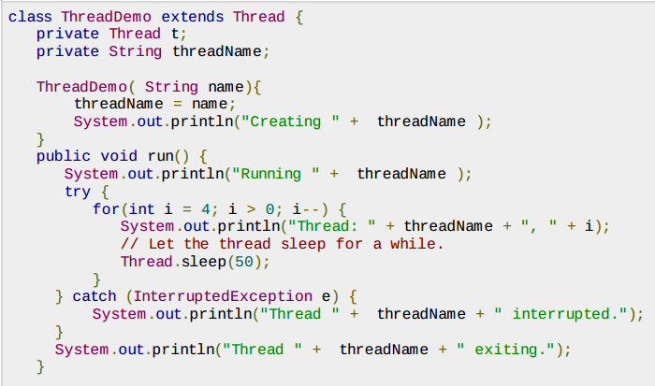
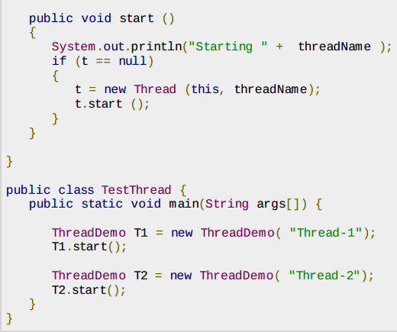
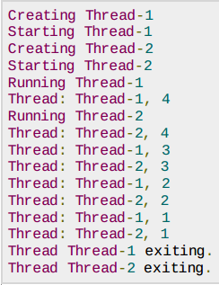
២. សែ្វងយល់ពី The Two Ways of Implementation Thread (ត)
ឧទាហរណ៍៖
Result:

Slide 11
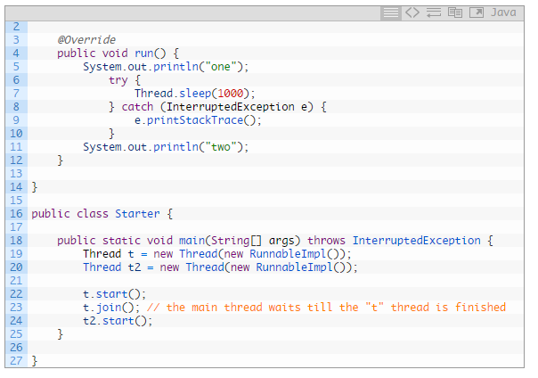
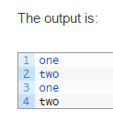
៣. សែ្វងយល់ពី​ Commonly Used Methods in Thread Class
Join() : allows one thread to wait for the completion of another.
Parameter
long millis : the length of time to sleep in milliseconds.

Slide 12
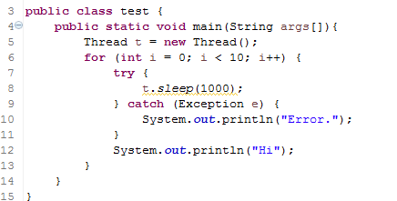
៣. សែ្វងយល់ពី​ Commonly Used Methods in Thread Class (ត)
Sleep() : The sleep() method causes the currently executing thread to sleep for X milliseconds. The thread does not lose ownership of any monitors.
Parameter
long millis : the length of time to sleep in miliseconds.
nanos : 0-999999 additional nanoseconds to sleep

Slide 13
៣. សែ្វងយល់ពី​ Commonly Used Methods in Thread Class (ត)
Wait() : cause the current thread to wait until either another thread invokes the notify() method or the notifyAll() method for this object, or a specified amount of times has elapsed.
the current thread must own this object monitor.
Parameter
long timeout : the maximum time to wait in miliseconds.

Slide 14
៣. សែ្វងយល់ពី​ Commonly Used Methods in Thread Class (ត)
Sleep() vs Wait() :
 | Sleep() | Wait()
Call on: | sleep(): Call on a Thread; always currently executing thread. | wait(): Call on an object; current thread must synchronize on the lock object.
Synchronized: | sleep(): when synchronized multiple threads wait for sleep over of sleeping thread. | wait(): when synchronized multiple threads access same Object one by one.
Hold lock: | sleep(): keep lock for at least t times if timeout specified or somebody interrupt. | wait(): release the lock for other objects to have chance to execute.
Wake-up condition: | sleep(): until at least time expire or call interrupt(). | wait(): until call notify(), notifyAll() from object
Usage: | sleep(): for time-synchronization and; | wait(): for multi-thread-synchronization.

Slide 15
៣. សែ្វងយល់ពី​ Commonly Used Methods in Thread Class (ត)
Notify() : wakes up a single thread that’s waiting in this object’s monitor. If any thread are waiting on this object, one of them is chosen to be awakened. A thread waits on an object’s minotr by calling on of the wait method.
Parameter
long timeout : the maximum time to wait in miliseconds.

Slide 16
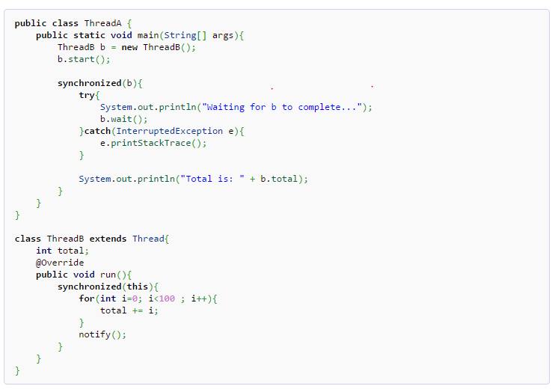

៣. សែ្វងយល់ពី​ Commonly Used Methods in Thread Class (ត)
Notify() & Wait() Example :
in the example above, an object, b is synchronized b completes the calculation before Main thread outputs its total value.

Slide 17
៤. ស្វែងយល់ពី Synchronization
Synchronization: ​មានសម្ថភាពសំរាប់គ្រប់គ្រងទៅលើការ Access នៃ Multiple Threads វាត្រូវបានប្រើដើម្បីឲ្យ Threads ដំណើរការម្ដងមួយៗ។
Synchronization: ត្រូវបានប្រើដើម្បី៖
To prevent thread interference.
To prevent consistency problem.

Slide 18
៤. ស្វែងយល់ពី Synchronization (ត)
Synchronization: មានពីរប្រភេទគឺ៖
Process Synchronization
Thread Synchronization

Slide 19
៤. ស្វែងយល់ពី Synchronization (ត)
Thread Synchronization: មានពីរប្រភេទគឺ៖
1. Mutual Exclusive : ជួយការពារ​​ Threads ពីការជ្រៀតចូលកំឡុងពេល Sharing Data។ គេអាចប្រើវាតាមរយៈ មធ្យោបាយ ៣ គឺ
Synchronized method.
Synchronized block.
static synchronization.
2. Cooperation (Inter-thread communication in java) : វាអនុញ្ញាតឲ្យ synchronized threads អាចធ្វើការទំនាក់ទំនងគ្នាបាន។

Slide 20
៤. ស្វែងយល់ពី Synchronization (ត)
Synchronized method
Lock ​ Object មួយសំរាប់ការ Share resource
Lock Method ទាំងឡាយណាដែលយើងចង់ឲ្យវា synchronized។
Synchronized block :
វាត្រូវបានប្រើដើម្បី Lock ​ Object មួយសំរាប់ការ Share resource.
Scope របស់ Synchronized block តូចជាង Synchronized method
Syntax to use synchronized block
synchronized (object reference expression) {
//code block }

Slide 21
៤. ស្វែងយល់ពី Synchronization (ត)
class Table{
void printTable(int n){
synchronized(this){//synchronized block
for(int i=1;i<=5;i++){
System.out.println(n*i);
try{ Thread.sleep(400);
}catch(Exception e){System.out.println(e);}
}
​​​​ }
}//end of the method
}
class MyThread1 extends Thread{
Table t;
MyThread1(Table t){
this.t=t; }
public void run(){
t.printTable(5); }
}
class MyThread2 extends Thread{
Table t;
MyThread2(Table t){
this.t=t; }
public void run(){
t.printTable(100); }
}

Slide 22
៤. ស្វែងយល់ពី Synchronization (ត)
public class TestSynchronizedBlock1{
public static void main(String args[]){
Table obj = new Table();//only one object
MyThread1 t1=new MyThread1(obj);
MyThread2 t2=new MyThread2(obj);
t1.start();
t2.start();
}
}

Slide 23
៤. ស្វែងយល់ពី Synchronization (ត)
static Synchronization :
វាត្រូវបានប្រើដើម្បី Lock ​ Object មួយសំរាប់ការ Share resource.
អាច Lock Object ច្រើន
Example:
class Table{
void printTable(int n){
synchronized(this){
for(int i=1;i<=10;i++){
System.out.println(n*i);
try{
Thread.sleep(400);
}catch(Exception e){}
}
}}}

Slide 24
៤. ស្វែងយល់ពី Synchronization (ត)
class MyThread1 extends Thread{
Table t;
MyThread5(Table t){this.t=t;}
public void run(){
t.printTable(1);
}
}
class MyThread1 extends Thread{
public void run(){
Table.printTable(1);
}
}
class MyThread2 extends Thread{
public void run(){
Table.printTable(10);
}
}
class MyThread3 extends Thread{
public void run(){
Table.printTable(100);
}
}

Slide 25
៤. ស្វែងយល់ពី Synchronization (ត)
class MyThread4 extends Thread{
public void run(){
Table.printTable(1000);
}
}
public class TestSynchronization4{
public static void main(String t[]){
MyThread1 t1=new MyThread1();
MyThread2 t2=new MyThread2();
MyThread3 t3=new MyThread3();
MyThread4 t4=new MyThread4();
t1.start();
t2.start();
t3.start();
t4.start();
}
}

Slide 26
៤. ស្វែងយល់ពី Synchronization (ត)
Diagram for synchronization
Thread
extends
MyThread1
MyThread2
MyThread3
MyThread4
Number
HAS-A
printNum()
Synchronized
N1
Synchronized Block
Synchronized Method

Slide 27
៤. ស្វែងយល់ពី Synchronization (ត)
Diagram for synchronization
Thread
extends
MyThread1
MyThread2
MyThread3
MyThread4
Number
HAS-A
printNum()
Static Synchronized
N1
N2
Static synchronized

Slide 28
៤. ស្វែងយល់ពី Synchronization (ត)
Diagram for synchronization
T1
Obj1
T2
T3
Obj2
T4

Slide 29
ឯកសារយោង
http://www.tutorialspoint.com/java/java_multithreading.htm
https://docs.oracle.com/javase/tutorial/essential/concurrency/sync.html
http://www.tutorialspoint.com/java/java_thread_synchronization.htm
http://nagarmero.blogspot.com/2012/01/difference-between-process-and-threads.html
https://www.youtube.com/watch?v=UolM07ScACw
https://docs.oracle.com/javase/tutorial/essential/concurrency/procthread.html
http://www.tutorialspoint.com/java/lang/java_lang_thread.htm
http://www.programcreek.com/2009/02/notify-and-wait-example/
http://www.javamadesoeasy.com/

Slide 30
សូមអរគុណ!!!

Slide 31
សូមស្វាគមន៍ចំពោះសំណួរ

